Slide 1
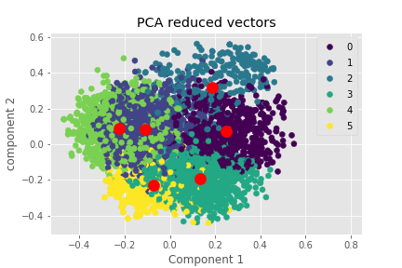
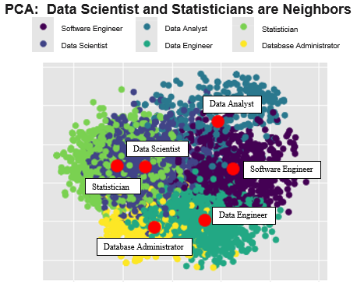
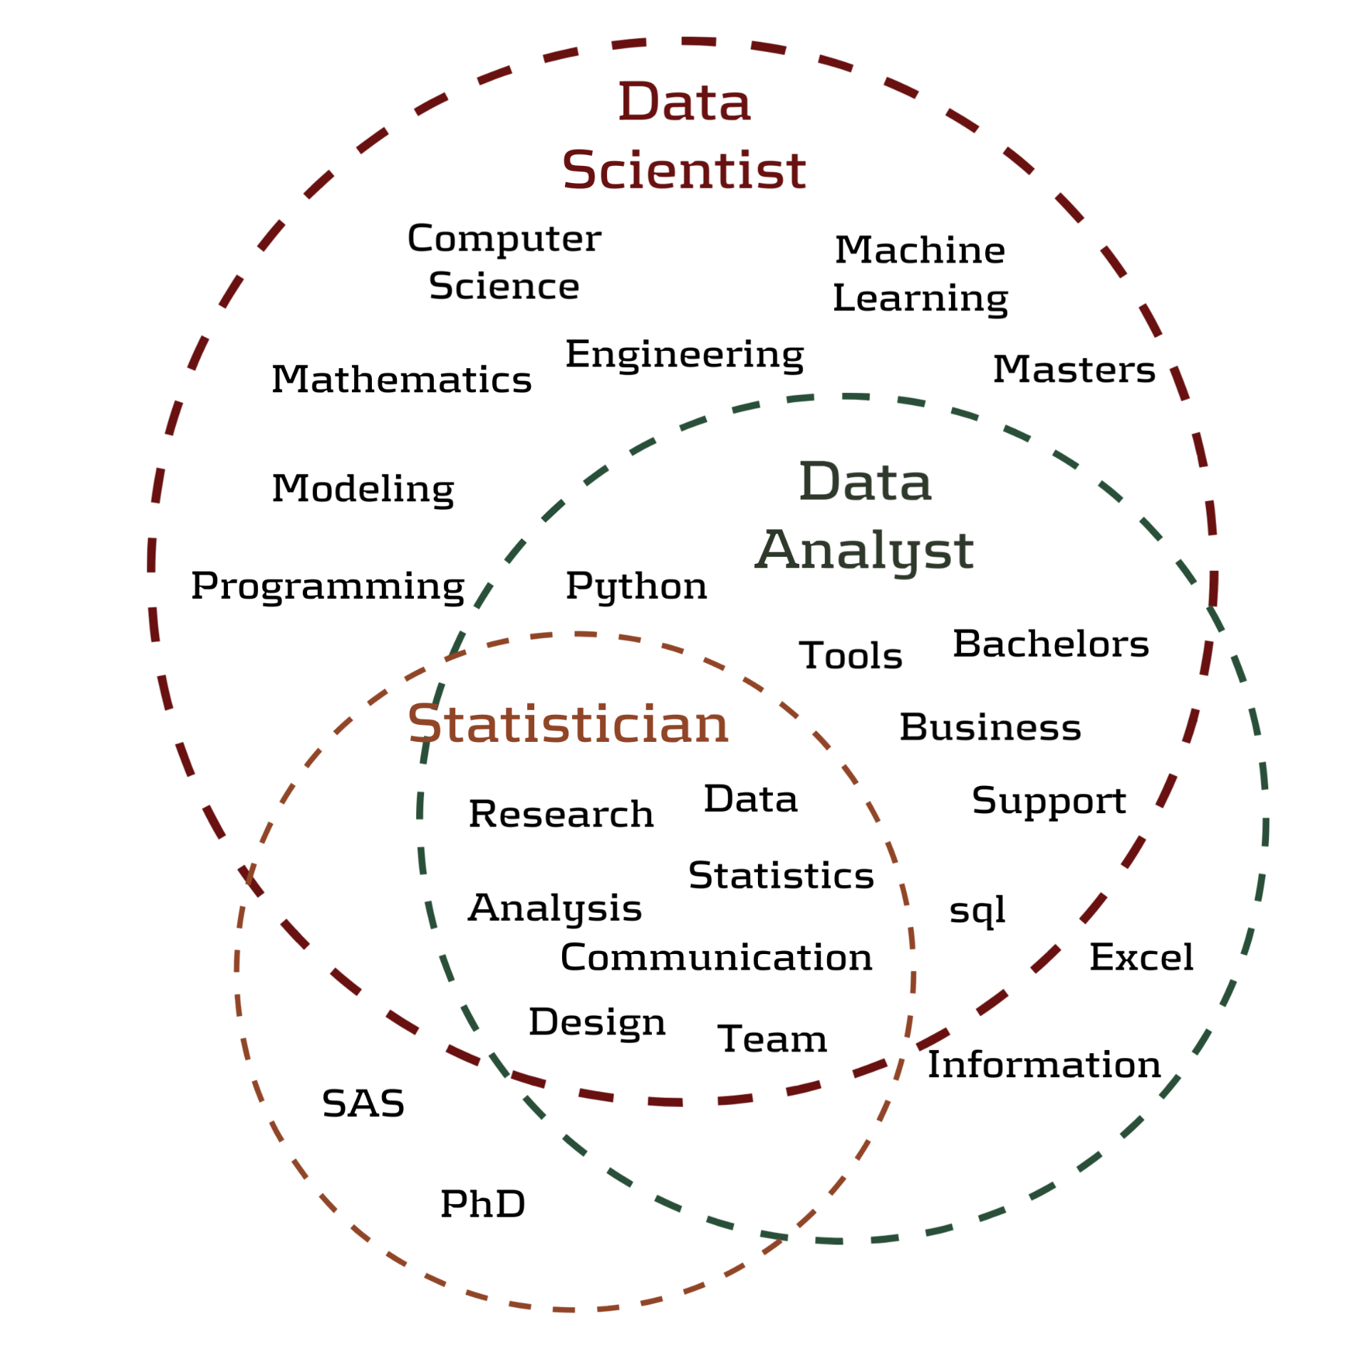
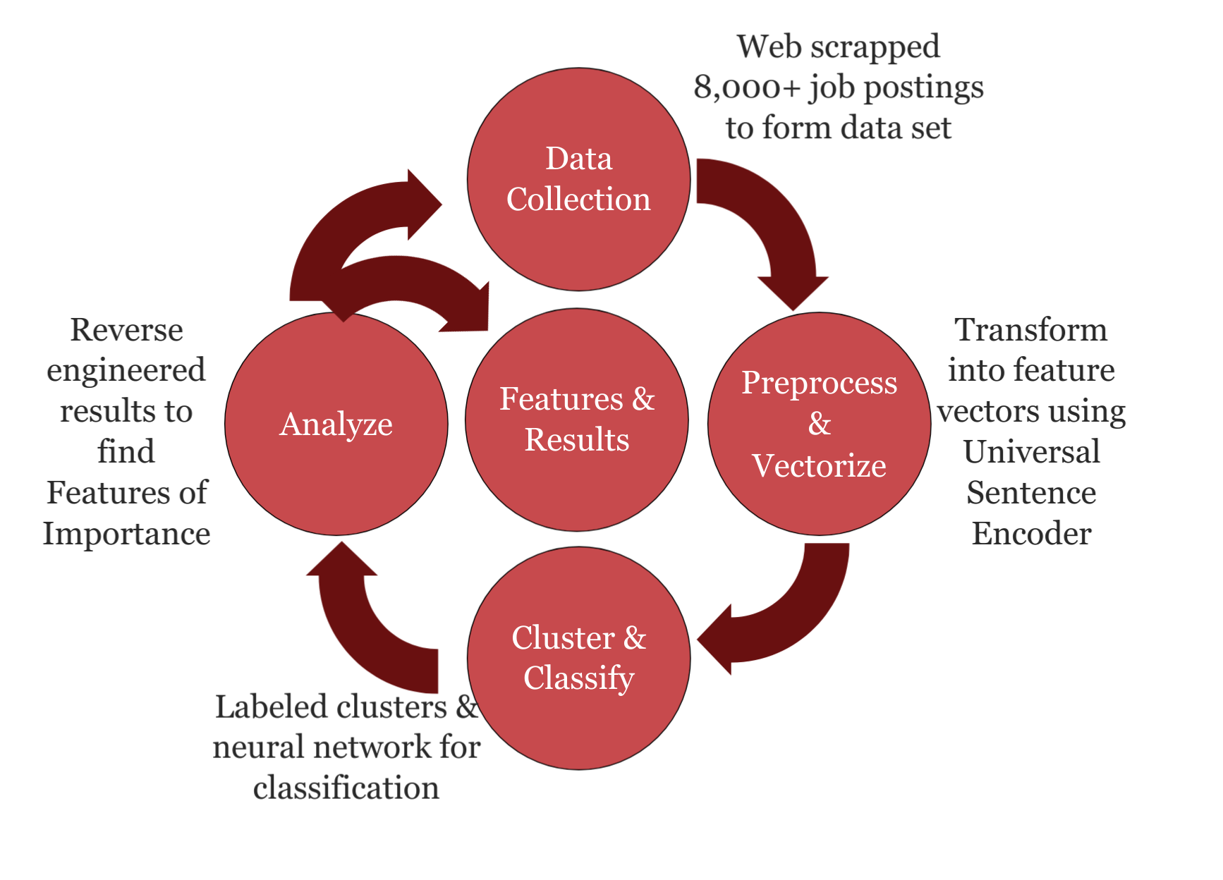
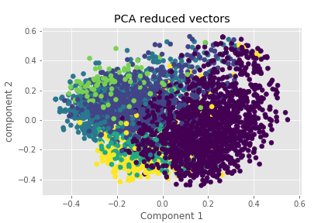
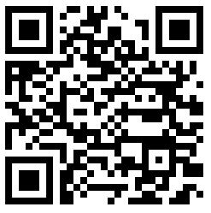




Software Engineer Data Analyst Statistician
Data Scientist Data Engineer Database Administrator
Non-Cognitive Predictors of Student Success: A Predictive Validity Comparison Between Domestic and International Students
A Data Science Approach to Define the Data Scientist
Non-Cognitive Predictors of Student Success: A Predictive Validity Comparison Between Domestic and International Students
k-means Clustering
54% accuracy in classification
Introduction
The definition of a Data Scientist is undecided - leading to unmet expectations, misfit hires, and lost time/resources for employers, employees, and applicants. Using state-of-art NLP and Machine Learning on 8,000+ job postings, we arrive at the features that define the ‘what is’ and cluster other job titles to understand the ‘who is’ a Data Scientist.
Most Frequent Words in Job Postings
Data Analyst
Data Scientist
Software Engineer
Statistician
Data Engineer
Database Administrator
A pair of clustering analysis was performed with PCA on the 512-dimensional vectors to visualize the similarities between the six job titles. Neural Net clustering (NNC) outperforms k-means by 31%. The NNC result provides guidance on the frequent words Venn diagram comparing Data Scientist to Data Analyst and Statistician.
Neural Net Clustering
85% accuracy in classification
Universal Sentence Encoder for Semantic Retrieval
A pre-trained text module in Tensorflow Hub, USE is a versatile sentence embedding model that encodes a corpus into 512-dimension vector - trained with a deep averaging network (DAN) encoder and transformer encoder. Once data is converted into a vector, we can quantify the similarity/differences for all job postings. More details can be found https://tfhub.dev.
Statistician
Data Scientist
Software Engineer
A Data Scientist codes, communicates, and collaborates – transforming data into insights using statistical, analytical, and machine learning techniques.
Data Analyst
Data Engineer
Database Administrator
Andy Ho An Nguyen Jodi Pafford
Dr. Robert Slater
Master of Science in Data Science
Interact with our data by visiting our Tableau Website
Southern Methodist University
Dallas, TX 75375, USA
Notes:
Notes:
In Powerpoint, click View > Guides
Keep text within gutter guides.
Author list: Don’t split names onto two lines (e.g., “Jimmy [break] Smith”). If that happens, use a new line, unless you need the space. Bold the first names of anybody who’s presenting in person.
Intro/methods/result: Do not drop below font size 28, but if you have extra space, jack up the font size until the space is full.
Do not use color in the sidebars except in graphs/figures. It’ll pull attention from the center and slow interpretation for passersby.

